Slide 1
Circuits
Section 4
Countdown to the end

Slide 2
Series and Parallel
Series: Two bulbs are in series if they are connected so the same current that passes through one bulb must also pass through the other.
http://www.stmary.ws/highschool/physics/home/animations3/electricity/circuits2_bigger.html
Parallel: Two bulbs are in parallel if their terminals are connected together so that at each junction one terminal of one bulb is directly connected to one terminal of the other.
http://www.stmary.ws/highschool/physics/home/animations3/electricity/series_resistance.html

Slide 3
Consequences
When two bulbs are connected in series, they have a single common junction and together, as a unit, constitute the only continuous path through that junction.
When two bulbs are connected in parallel, current that passes through one bulb does not pass through the other.
(the converse of this last one is not true - example of not sharing current when they are not parallel?)

Slide 4
Current
Currently (har har), how do we measure the current in a circuit?
In order to measure the current by using a bulb, how does it need to be connected to the circuit?

Slide 5
Current
Current can be measured in a unit called an Ampere (A).
You may have heard of “Amps” – Ex?
mA = milliampere = one-thousandth of an Ampere.

Slide 6
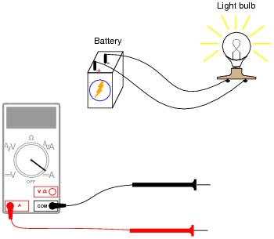
Current
We will be able to measure current with something called an ammeter.
The device allows current to pass through it without altering the resistance of the circuit very much.
How do you think we
will hook up our ammeters
to our circuits?

Slide 7
Resistance
We have said that resistance is an obstacle to the current in a circuit.
One obstacle has been a bulb. Can you think of another one?
We can use resistors in our circuits rather than bulbs. These are created to have the same resistance, no matter the current, unlike a bulb.

Slide 8
Symbols
Ammeter:
Resistor:
http://www.stmary.ws/highschool/physics/home/animations3/electricity/metersCircuits.html

Slide 9
Current and Junctions
Whenever circuit elements are connected, they form a node.
Exp. 5.5
  Identify all the nodes in the circuit.
  Find the current into and out of each node.
  How does the current into a node compare to the current out of the node?
  How might you express this mathematically?

Slide 10
Quick Quiz 1
1) Draw a picture of the batteries in the battery holders, labeling the positive and negative terminals.
  a) In our battery holders, are the batteries connected in series or parallel?
  b) How can you tell?

Slide 11
Quick Quiz 2
Two students are predicting the brightness of identical bulbs in the circuit on the board.
Student 1 “All the current is through A. Then it divides between B and C so they will be equally dim, lots dimmer than A. Then the current comes together again and it all goes through D. Bulb D will be the same brightness as bulb A.”
Student 2 “I think D will be a lot dimmer than A; in fact, maybe it won’t light at all. There won’t be much current left after it passes through A and B and C. Maybe D will be bright and A will be dim, it depends on the direction of the flow through the circuit. This would be a good test to find the direction of current.”

Slide 12
Kirchhoff’s First Rule
Kirchhoff’s First Rule:
  The total current out of a node is equal to the total current into the node.
  (current in = current out)
  i₁ + i₂ = i₃ + i₄ +i₅
  The algebraic sum of the currents at a node is zero.
  i₁ + i₂ – i₃ –i₄ –i₅ = 0

Slide 13
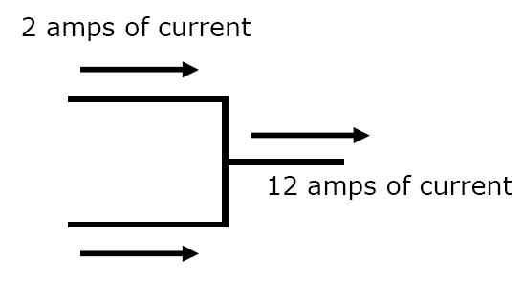

Slide 14

Inside a circuit
Model for an atom:
The nucleus in the center of the atom is filled with Neutrons and Protons. Protons have a positive charge, and Neutrons are neutral and have no charge.
What sort of charge might electrons have?

Slide 15
Inside a circuit
Some atoms have electrons that are able to leave one atom and travel to the next atom.
Metals and other conductors are in this category.
Use firefox
http://www.stmary.ws/highschool/physics/home/animations3/electricity/electrons_conductivity.html

Slide 16
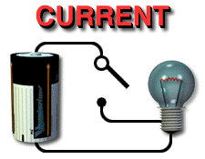
Inside a circuit
When there is a complete circuit, current is flowing.
This means that electrons are moving from one atom to another atom.

Slide 17
Inside a circuit
If I have a negative charge, will it want to be closer to a positive charge or another negative charge?
How is this like how a magnet works?

Slide 18
Read chapter 23, p.436 to 442.
Make a list of all the terms you find that are in bold.
Write a definition for each term.
Write down any formulas they show you.

Slide 19
Chapter 23
Flow of Charge – rate of movement of electric charge
Electric Current – movement of electrons in a circuit – these charges move from one atom to another
We have seen this in our classroom when we noticed the brightness of the bulbs

Slide 20
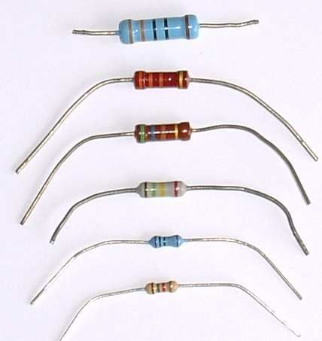
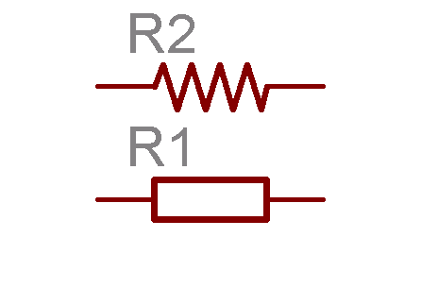
More Chapter 23
Electrical Resistance – different materials have different resistances
  Like an obstacle to the current
  Like the width of a pipe – wider = easier flow = more current
  Measured in Ohms - Ω
How do conductors and insulators fit into this picture?

Slide 21
Current and Voltage
Charge is said to flow THROUGH a circuit
Current is said to be THROUGH a bulb
Voltage is said to be placed ACROSS a circuit
Voltage can be calculated ACROSS a battery
Why? (hint: what are the definitions of the two words)
How do we measure current and voltage?

Slide 22
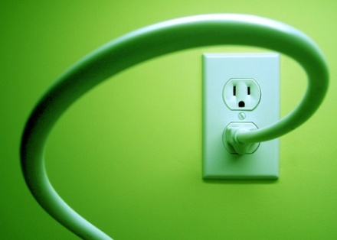
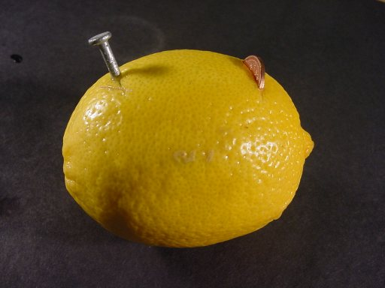
Chapter 23
Voltage Source – This could be a battery, a generator, a wall socket,
  Must have a potential difference
  Measured in Volts
Potential Difference – When ends of an electrical conductor are at different electric potentials
  Like heat flowing from something hot to something cold
  When you connect something with a potential difference with a conductor, electrons start moving
  Ex: Power lines, sockets, battery terminals,

Slide 23
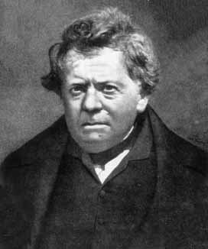
Ohm’s Law
George Simon Ohm –
1789 – 1854
Taught math
Most physicists did not use math, just observed
He combined observations and math

Slide 24
Ohm’s Law
We will figure out how current, resistance, and voltage relate by combining observations and math.

Slide 25
Ohm’s Law
voltage = resistance ? current
resistance = voltage ? current
current = voltage ? resistance

Slide 26
Questions
How much current is drawn by a lamp that has a resistance of 60 Ω when a voltage of 12 V is impressed across it?
What is the resistance of an electric frying pan that draws 12 A when connected to a 120 V circuit?

Slide 27
Ohm’s Law
Ohm’s Law and Electric Shock
What causes electric shock – current or voltage?
At a resistance of 100,000 Ω, what will be the current in your body if you touch the terminals of a 12 V battery?
If your skin is very moist – so that your resistance is only 1,000 Ω, and you touch the terminals of a 12 V battery, how much current do you receive?

Slide 28
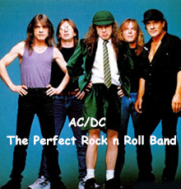
AC/DC
Alternating Current
Direct Current

